Slide 1
Why Visualize Data?
What is Data Visualization and why bother?

Slide 2


Slide 3
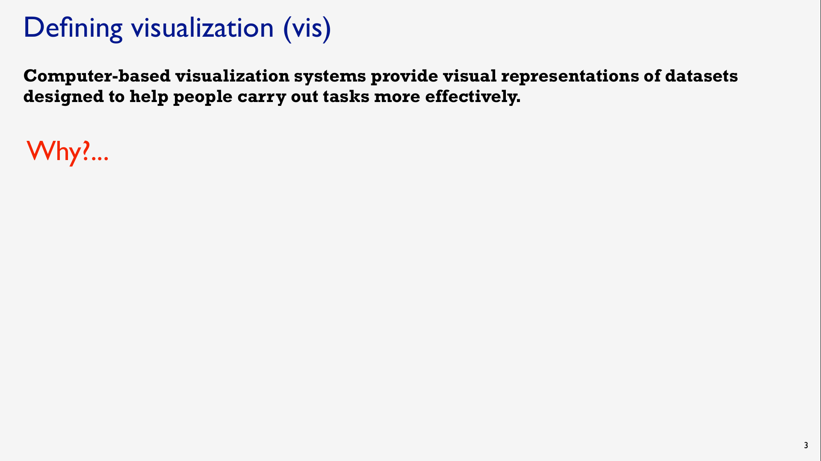

Slide 4
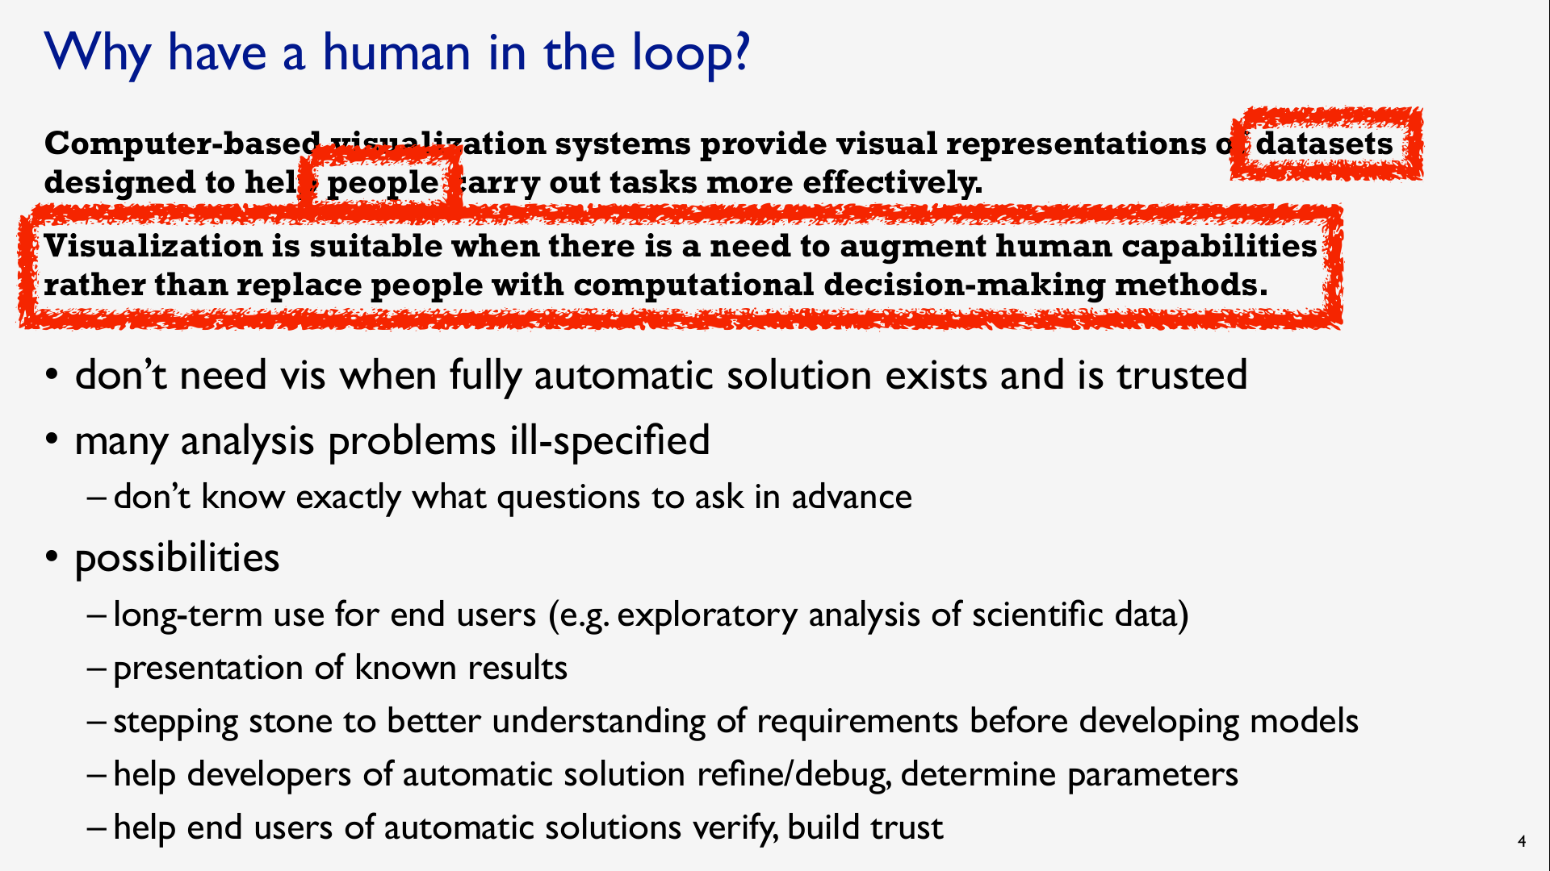

Slide 5
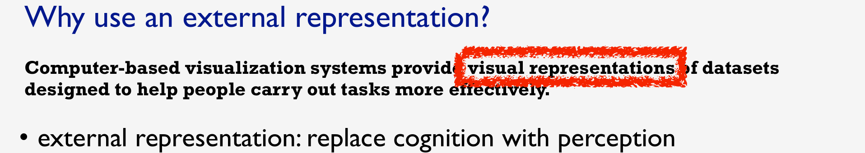

Slide 6
Example: Religions by Country
Which country has the most Hindus? The Data
The Visualization

Slide 7
Example: Migrant Deaths
When and where did migrant deaths occur?
Are there any patterns or trends? The Data
The Visualization

Slide 8
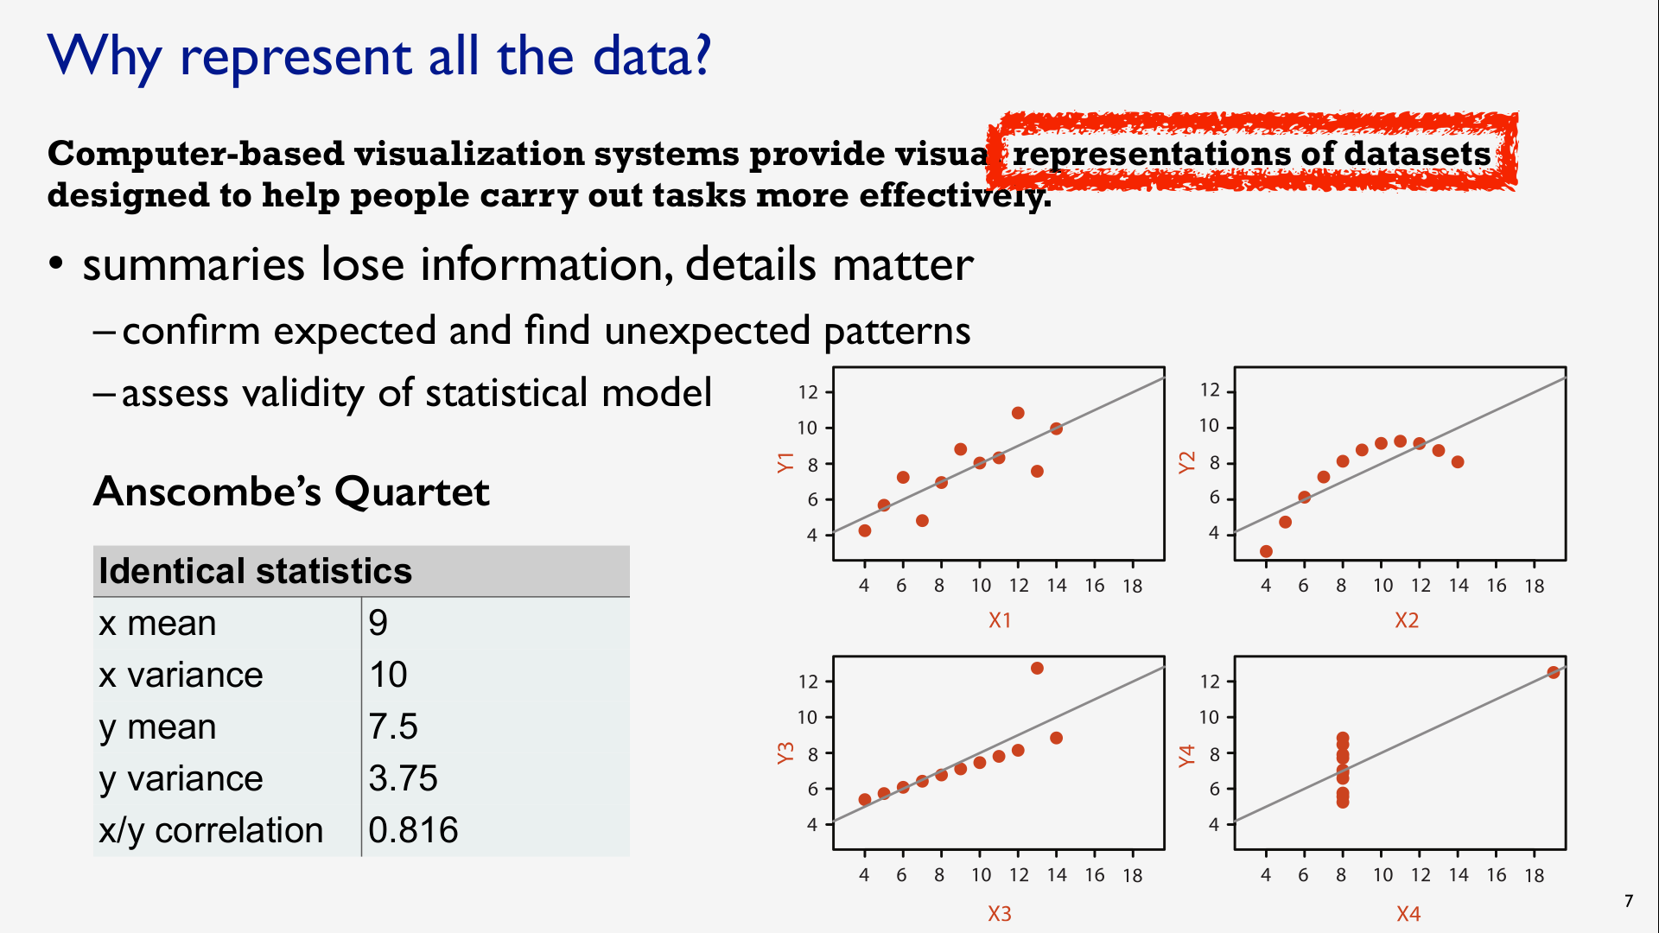

Slide 9
Input for Visualization
Data and Tasks

Slide 10
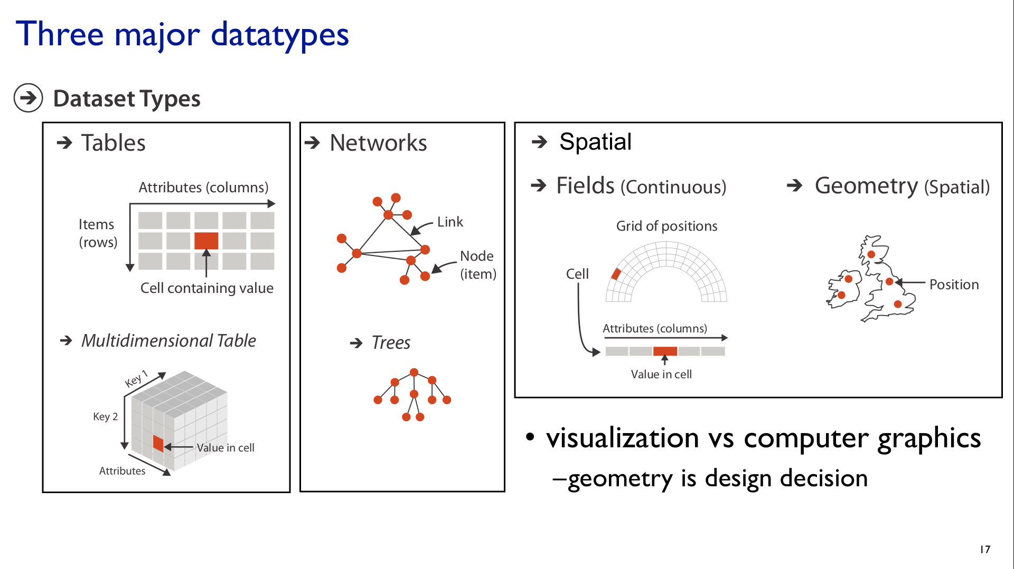

Slide 11
Attribute Types
Broad taxonomy for visualization design

Slide 12
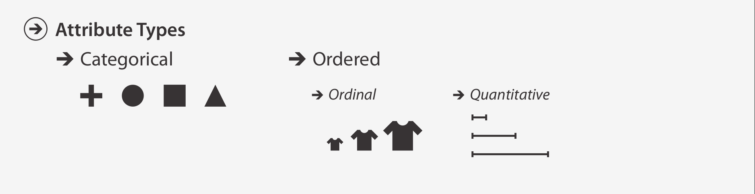

Slide 13
Challenge
Identify attribute types
Religion by Country Data
Migrant Deaths Data

Slide 14
Special Cases
Time
Point in time
Region of time
Space
Point in space
Region of space

Slide 15
 | Point | Region
Space
Time
Quantity
(Latitude, Longitude)
e.g. “My current location”
Geographic Identifier e.g. Countries, States, Counties
Quantitative
Categorical
Instant
e.g. “Right now”
Interval
e.g. “This year”
Quantitative
Ordinal
Value e.g. 5.2
Interval
e.g. “5 - 10 years old”
Quantitative
Ordinal

Slide 16
Challenge
Identify attribute types
The Religion by Country Data
The Migrant Deaths Data

Slide 17
Tasks
What questions do you want to answer?
What is the problem you are trying to solve?
What decisions are you trying to make?
What outcomes are you hoping for?
What story do you want to tell?
What tasks should the viewer be able to perform?

Slide 18
Marks & Channels
in Data Visualization

Slide 19
Topics
Marks Points, Lines, Areas
Channels Position, Color, Shape
How to choose marks & channels based on attribute types & tasks

Slide 20
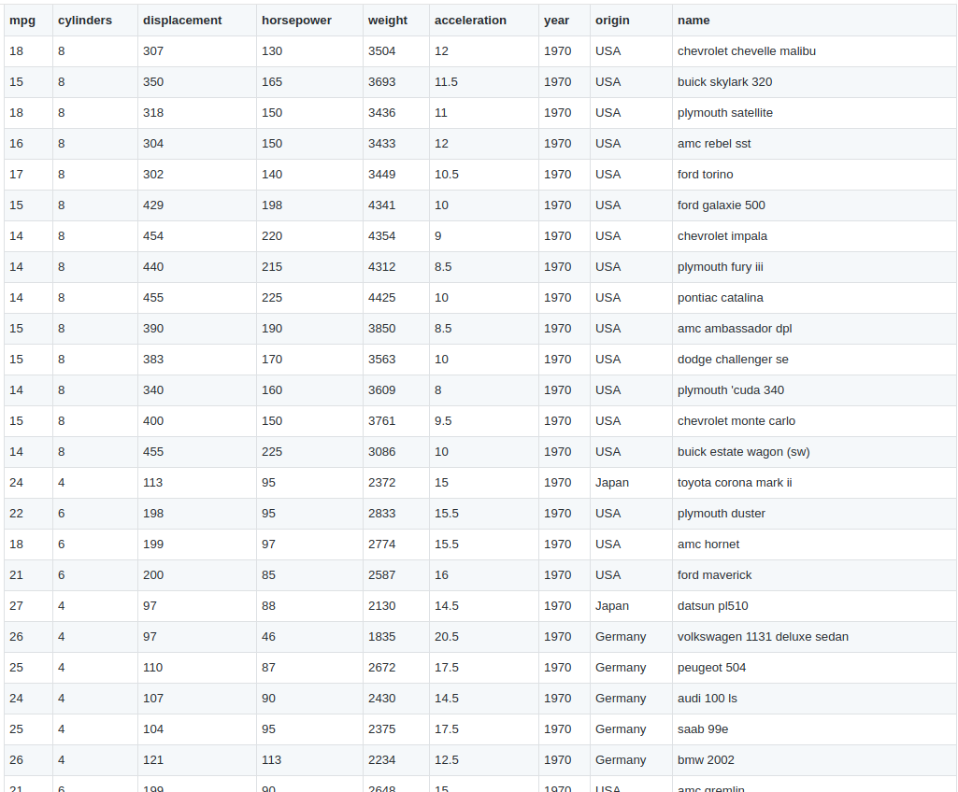
Columns → Channels
Position | Color | Size
Rows → Marks
Points | Lines | Areas

Slide 21


Marks
Channels
Ordered
Quantitative
X Position | ⚫ | ⚫ | ⚫
Y Position | ⚫ | ⚫ | ⚫
Area |  | ⚫ | ⚫
Luminance |  | ⚫ | ⚫
Hue | ⚫
Points | Lines | Areas
Categorical
Position
Size
Color
Visualization

Slide 22
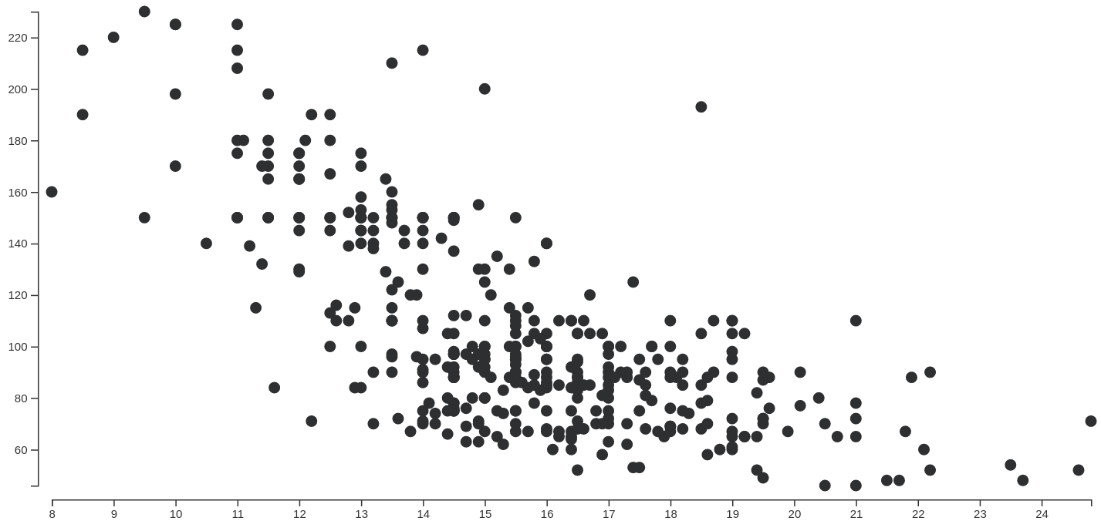
Points | Lines | Areas
X Position |  |  | ⚫
Y Position |  |  | ⚫
Area
Luminance
Hue
Categorical
Ordered
Quantitative
http://bl.ocks.org/curran/101dafa2f34850c451ed5ba014459a34

Slide 23
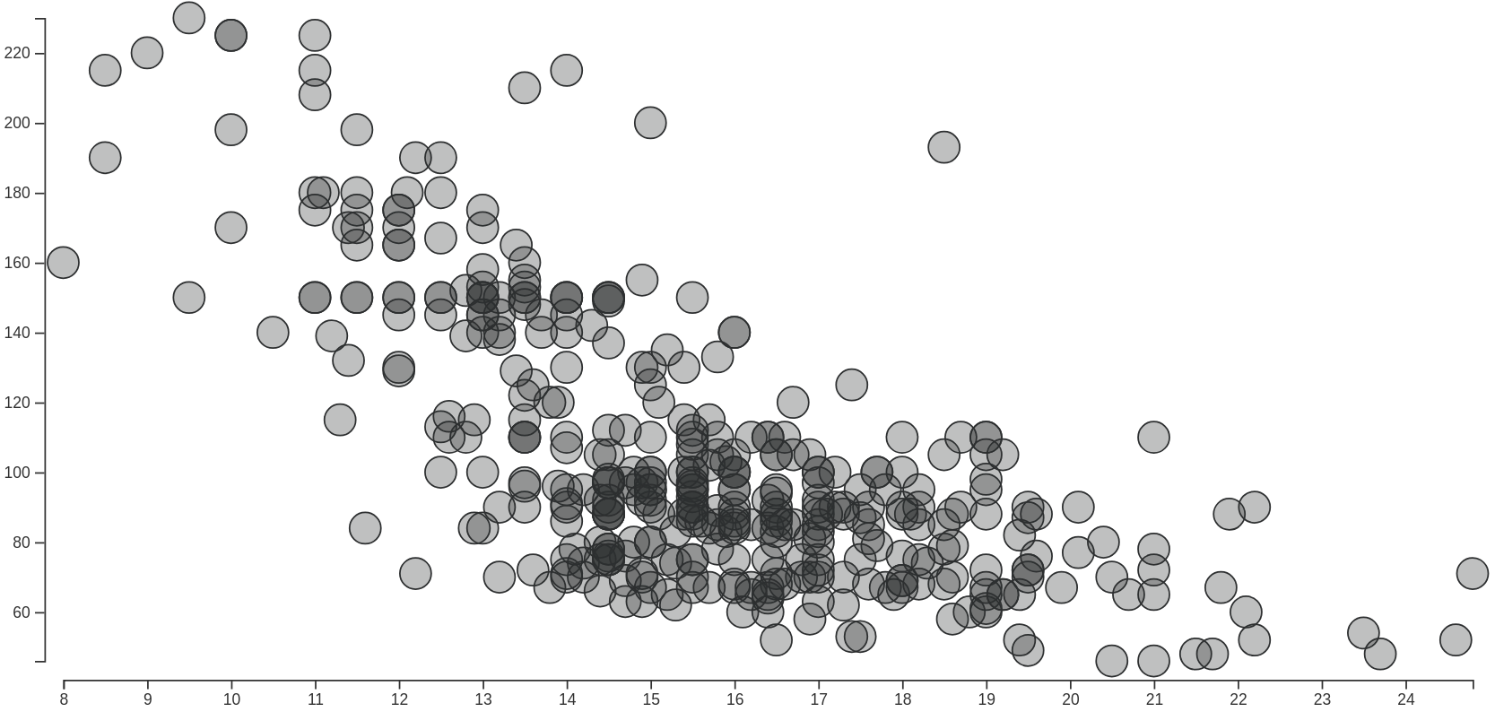
Points | Lines | Areas
X Position |  |  | ⚫
Y Position |  |  | ⚫
Area
Luminance
Hue
Categorical
Ordered
Quantitative
http://bl.ocks.org/curran/7139a24064265b3458f825b0d6152e80

Slide 24
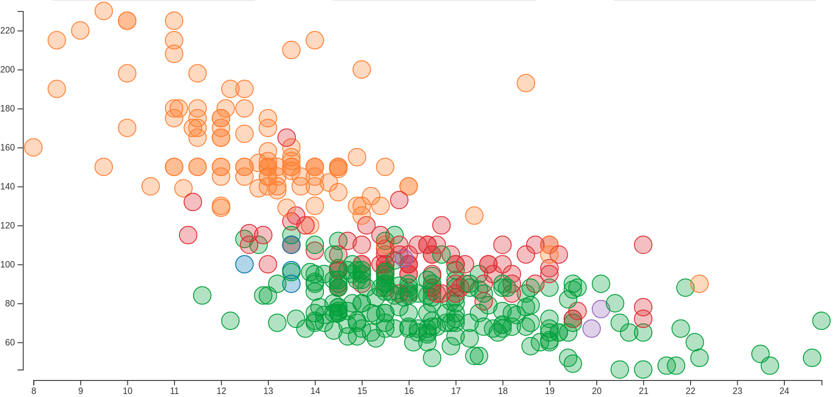
Points | Lines | Areas
X Position |  |  | ⚫
Y Position |  |  | ⚫
Area
Luminance
Hue | ⚫
Categorical
Ordered
Quantitative
https://bl.ocks.org/curran/966ac9f212a8ceb1ea153fd1ee9f72c4

Slide 25
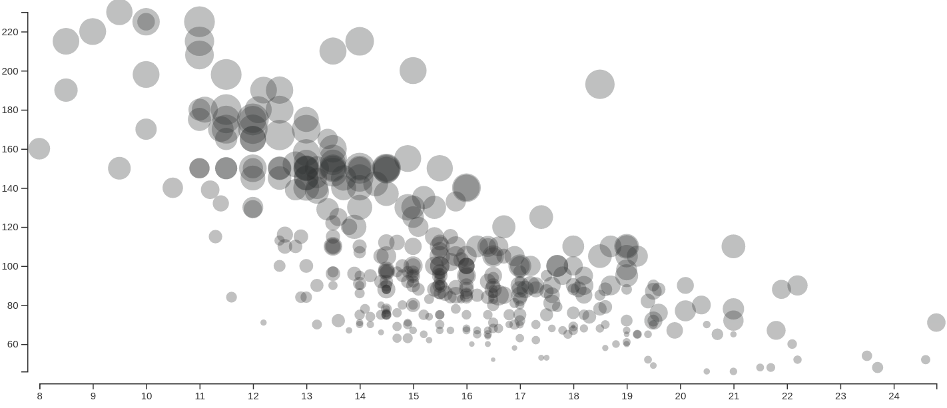
Points | Lines | Areas
X Position |  |  | ⚫
Y Position |  |  | ⚫
Area |  |  | ⚫
Luminance
Hue
Categorical
Ordered
Quantitative
http://bl.ocks.org/micahstubbs/b097f9d0999848ee70b74b36ce30cbb8 (tweaked)

Slide 26
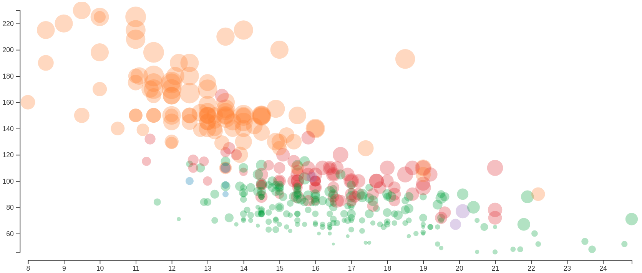
Points | Lines | Areas
X Position |  |  | ⚫
Y Position |  |  | ⚫
Area |  |  | ⚫
Luminance
Hue | ⚫
Categorical
Ordered
Quantitative
http://bl.ocks.org/micahstubbs/b097f9d0999848ee70b74b36ce30cbb8

Slide 27
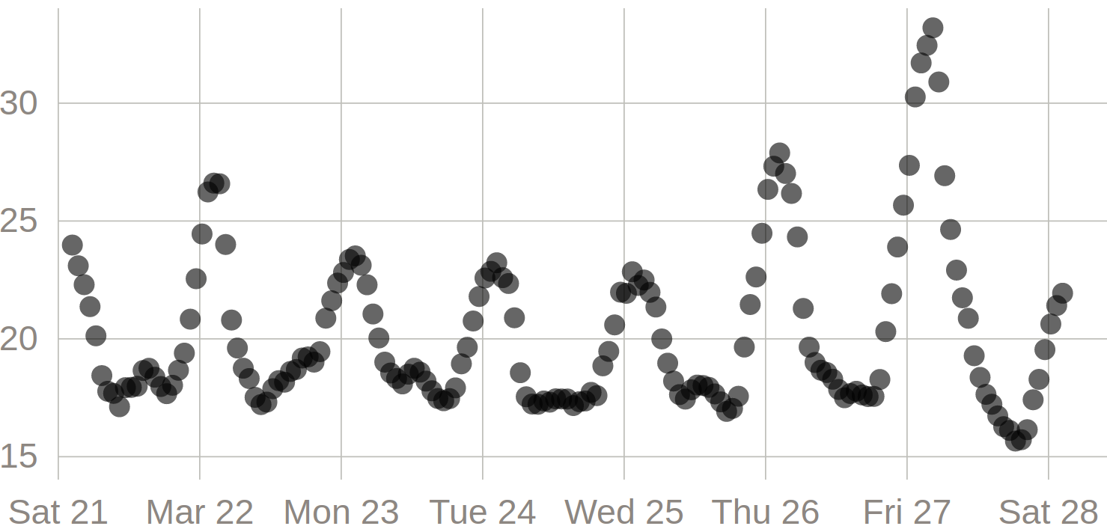
Points | Lines | Areas
X Position |  |  | ⚫
Y Position |  |  | ⚫
Area
Luminance
Hue
Categorical
Ordered
Quantitative
https://bl.ocks.org/curran/3f2ff2e32652397de94d406460e240ce

Slide 28
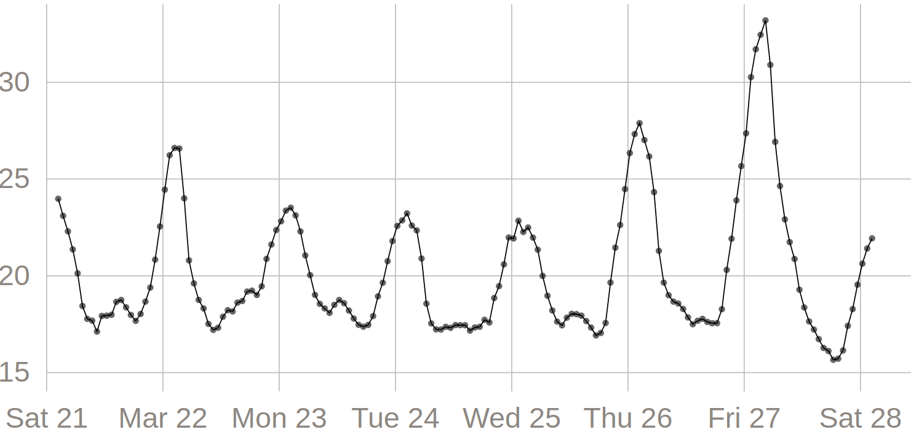
Points | Lines | Areas
X Position |  |  | ⚫
Y Position |  |  | ⚫
Area
Luminance
Hue
Categorical
Ordered
Quantitative
https://bl.ocks.org/curran/ba21316eafc6b84b22d1a5d49ad2a798

Slide 29
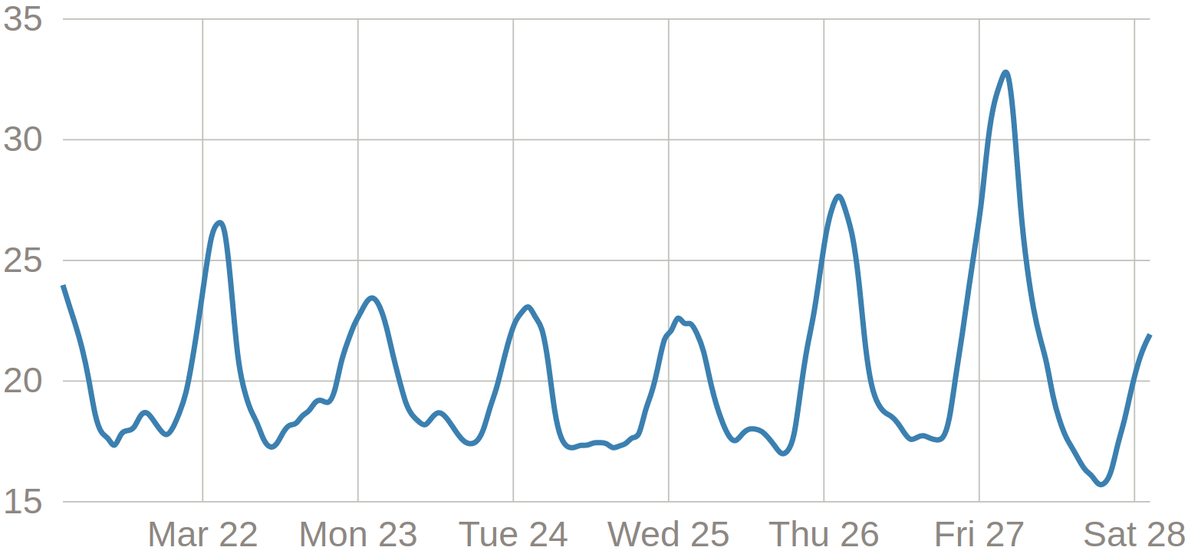
Points | Lines | Areas
X Position |  |  | ⚫
Y Position |  |  | ⚫
Area
Luminance
Hue
Categorical
Ordered
Quantitative
https://bl.ocks.org/curran/90240a6d88bdb1411467b21ea0769029

Slide 30
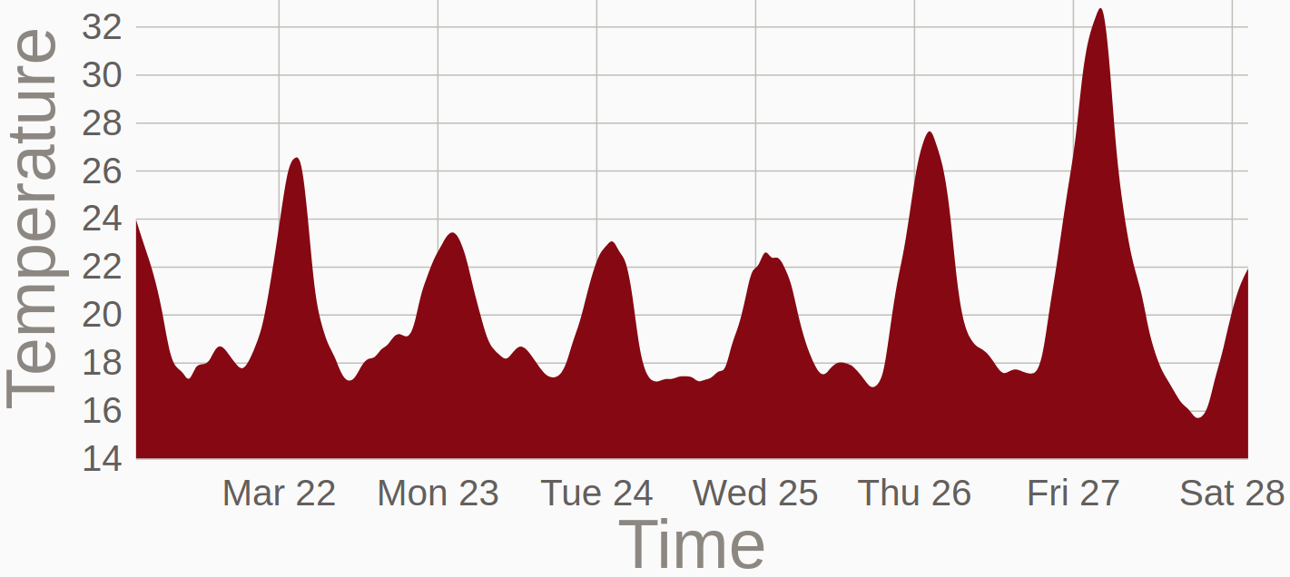
Points | Lines | Areas
X Position |  |  | ⚫
Y Position
Area |  |  | ⚫
Luminance
Hue
Categorical
Ordered
Quantitative
https://vizhub.com/curran/585f19b2564e484188f4c60f1faf828e

Slide 31
Points | Lines | Areas
X Position |  |  | ⚫
Y Position
Area |  |  | ⚫
Luminance
Hue
Categorical
Ordered
Quantitative
Misleading → Needs zero baseline!
Not a zero baseline! Domain should start at zero.
https://vizhub.com/curran/585f19b2564e484188f4c60f1faf828e

Slide 32
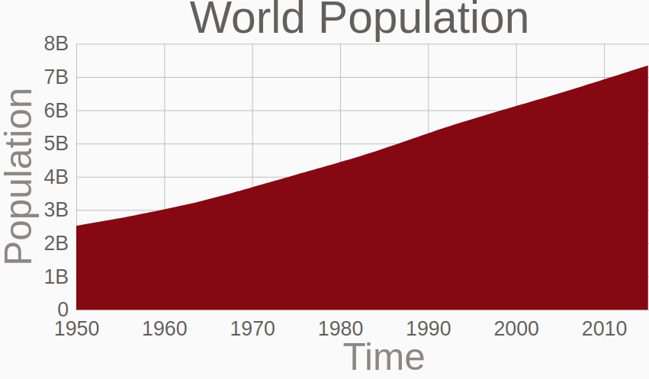
Points | Lines | Areas
X Position |  |  | ⚫
Y Position
Area |  |  | ⚫
Luminance
Hue
Categorical
Ordered
Quantitative
https://vizhub.com/curran/900cb204023748b9a8bdf2273bdefe03

Slide 33
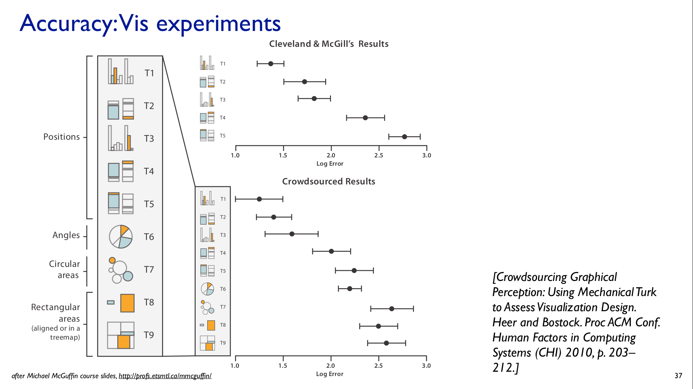

Slide 34
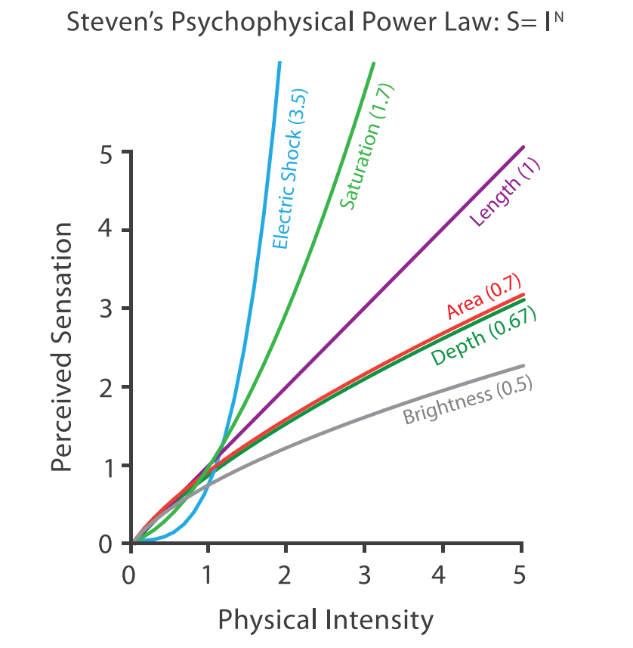

Slide 35
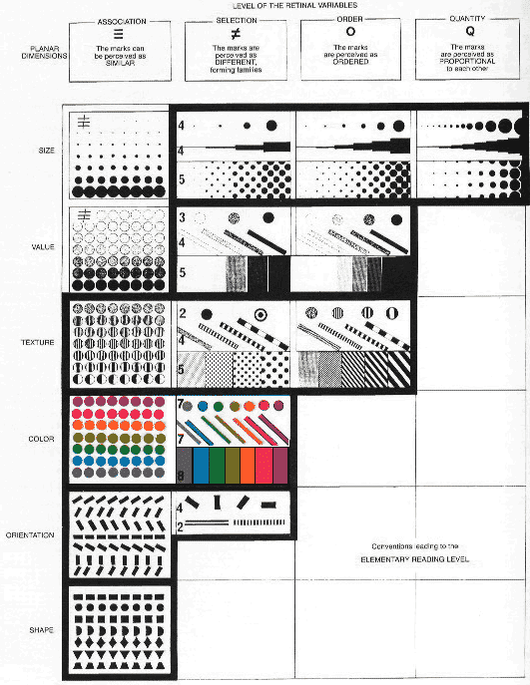
From Jacques Bertin - Semiology of Graphics

Slide 36
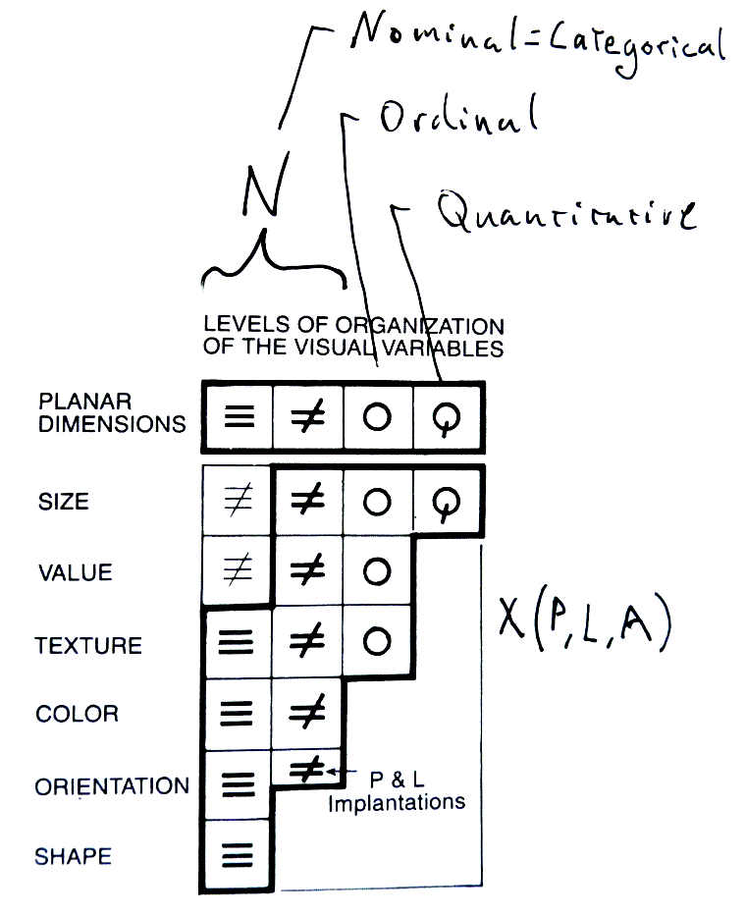
Channels
Ordered
Quantitative
X Position | ⚫ | ⚫ | ⚫
Y Position | ⚫ | ⚫ | ⚫
Area |  | ⚫ | ⚫
Luminance |  | ⚫ | ⚫
Hue | ⚫
Categorical
Position
Size
Color
From Jacques Bertin “Semiology of Graphics”

Slide 37
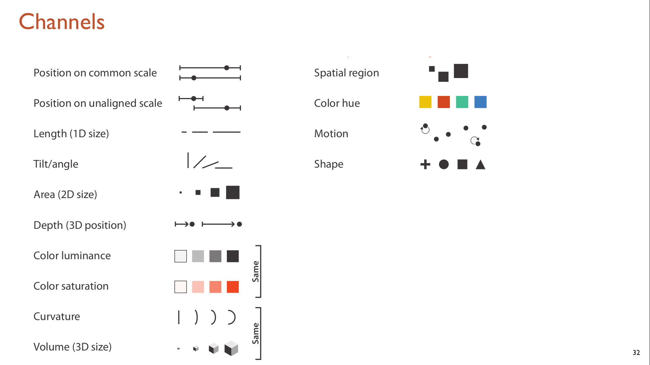

Slide 38
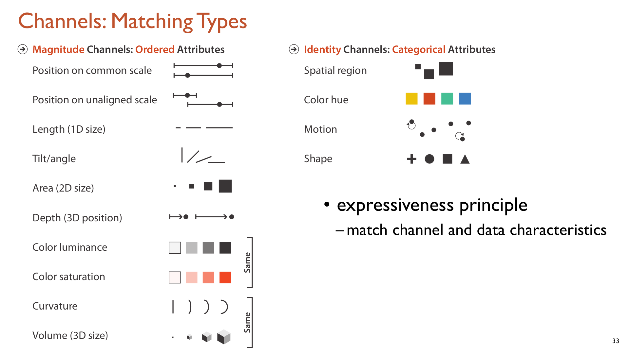

Slide 39
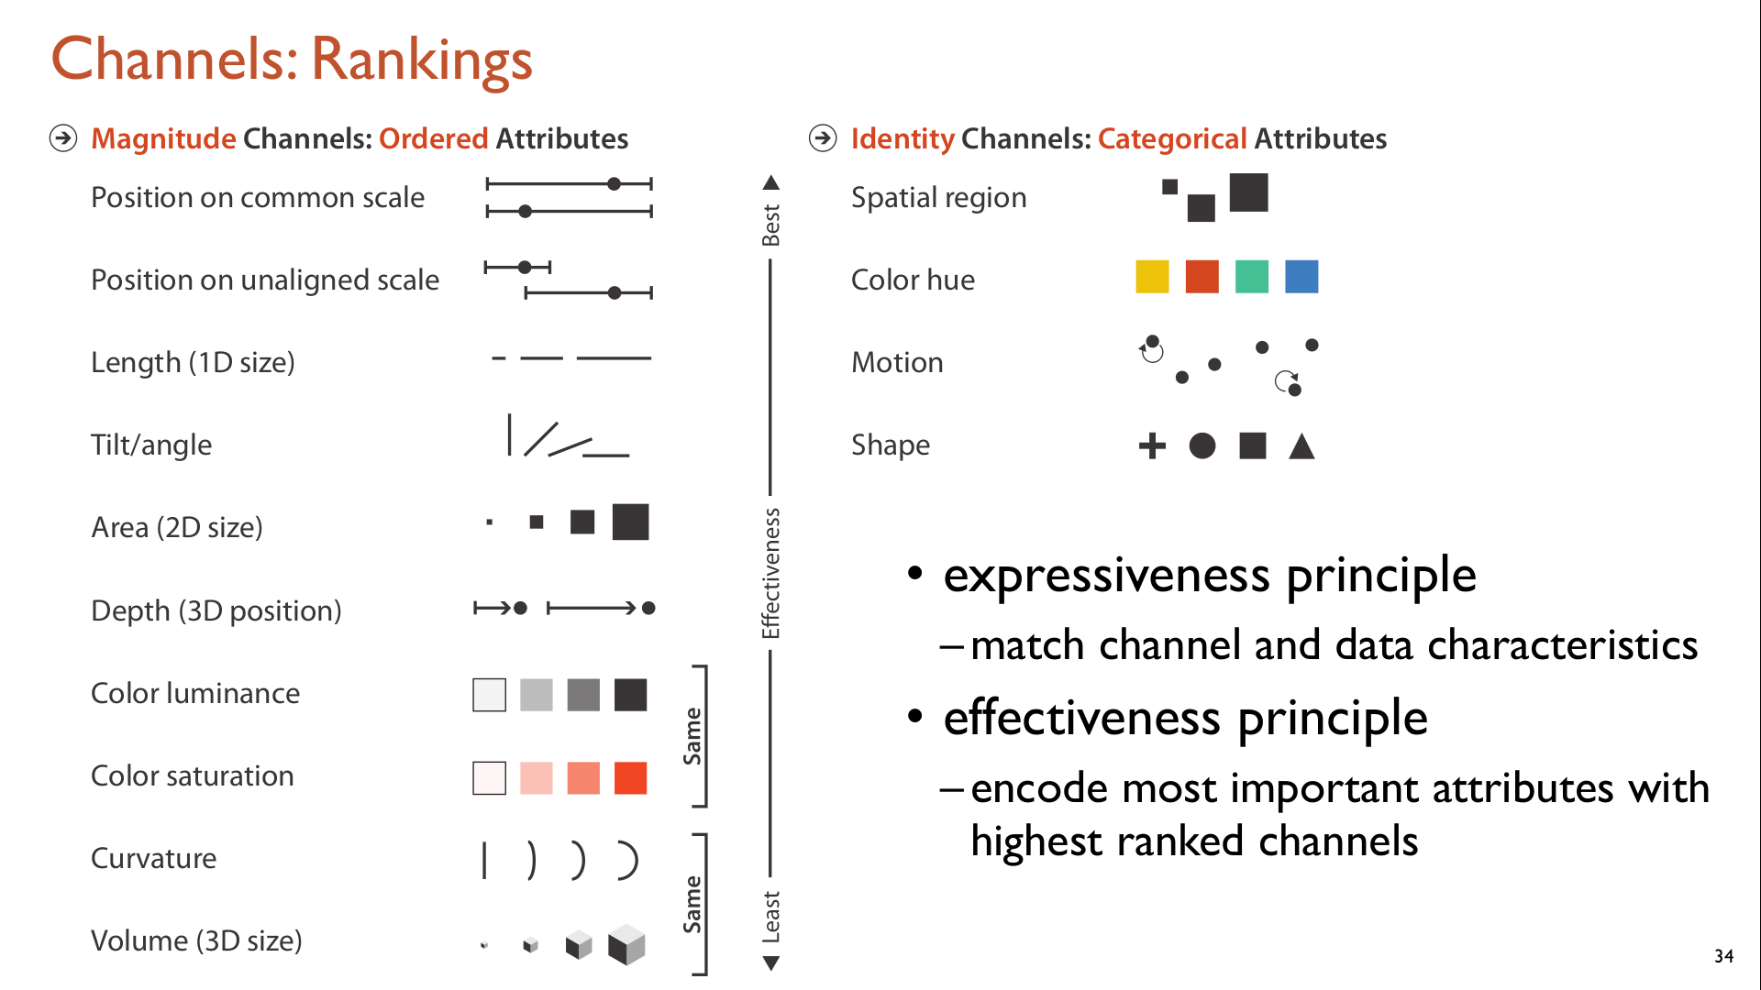

Slide 40
Depends on the task!

Slide 41
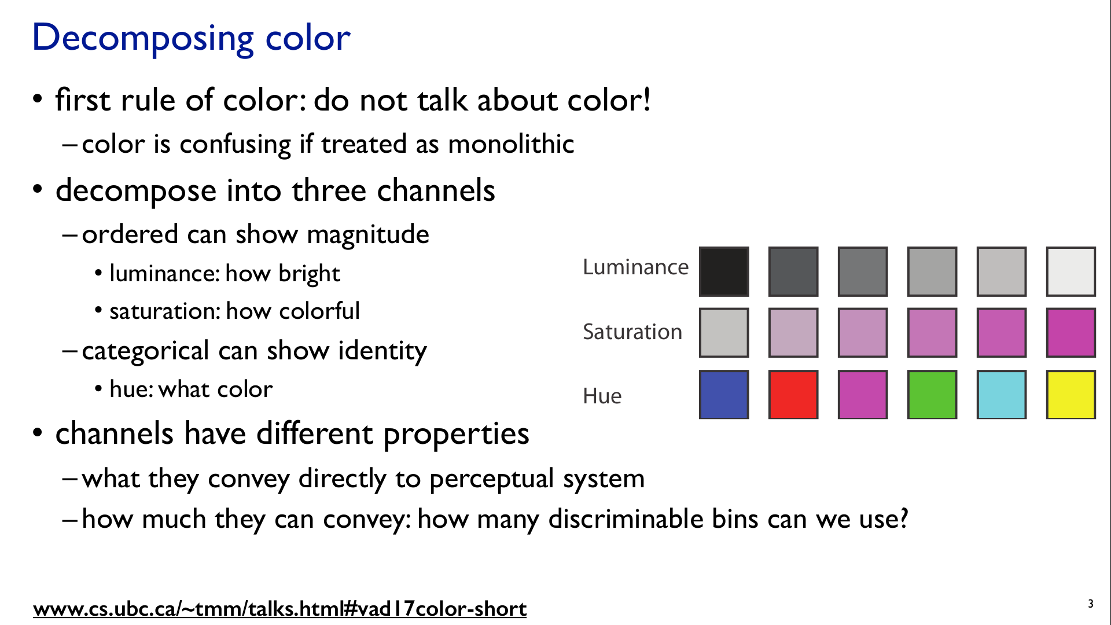

Slide 43
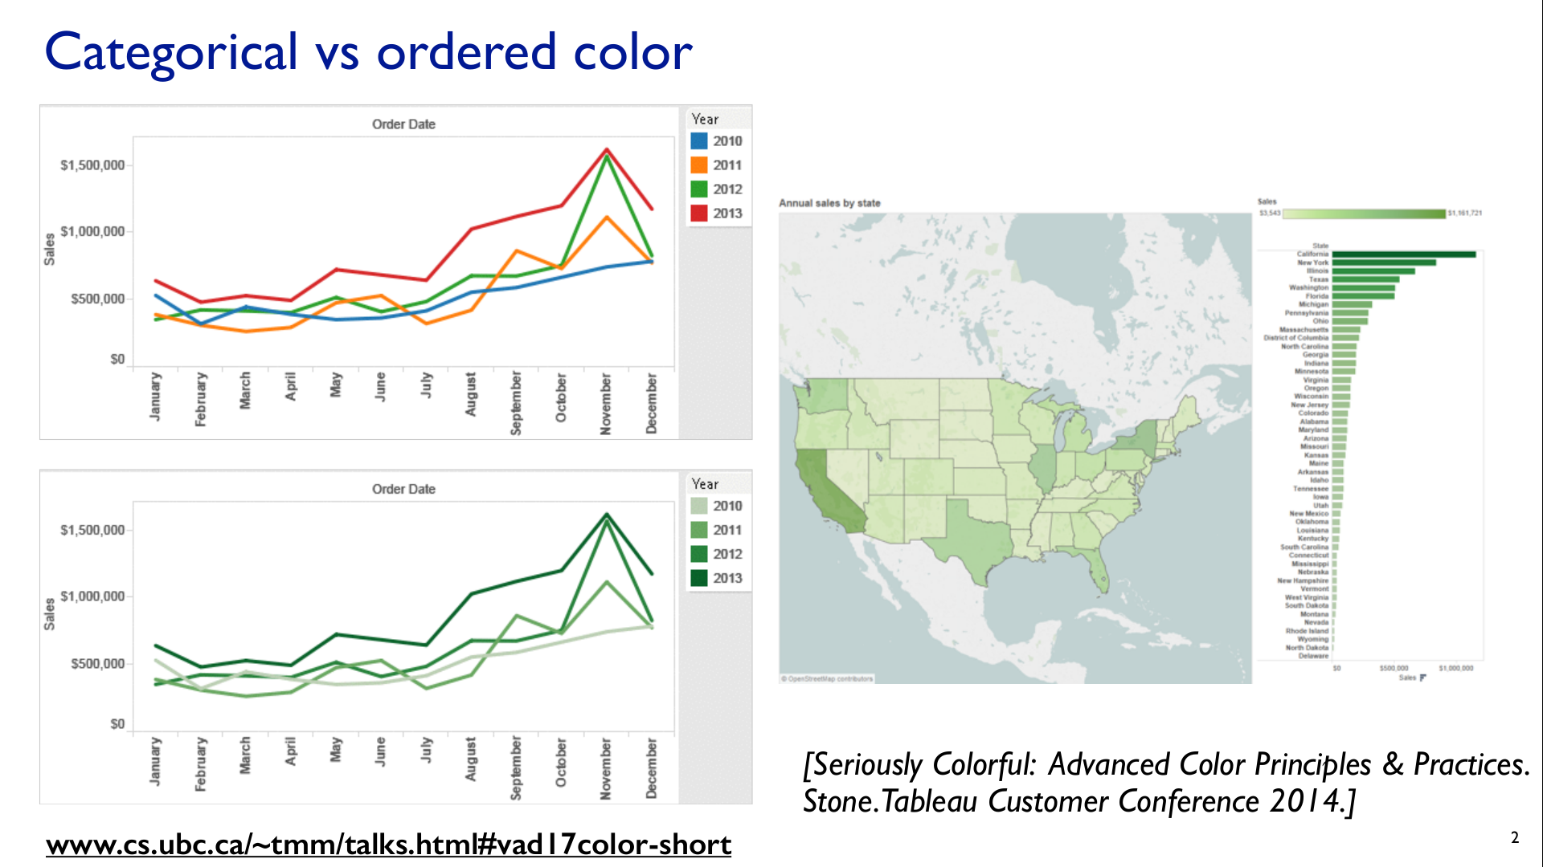

Slide 44
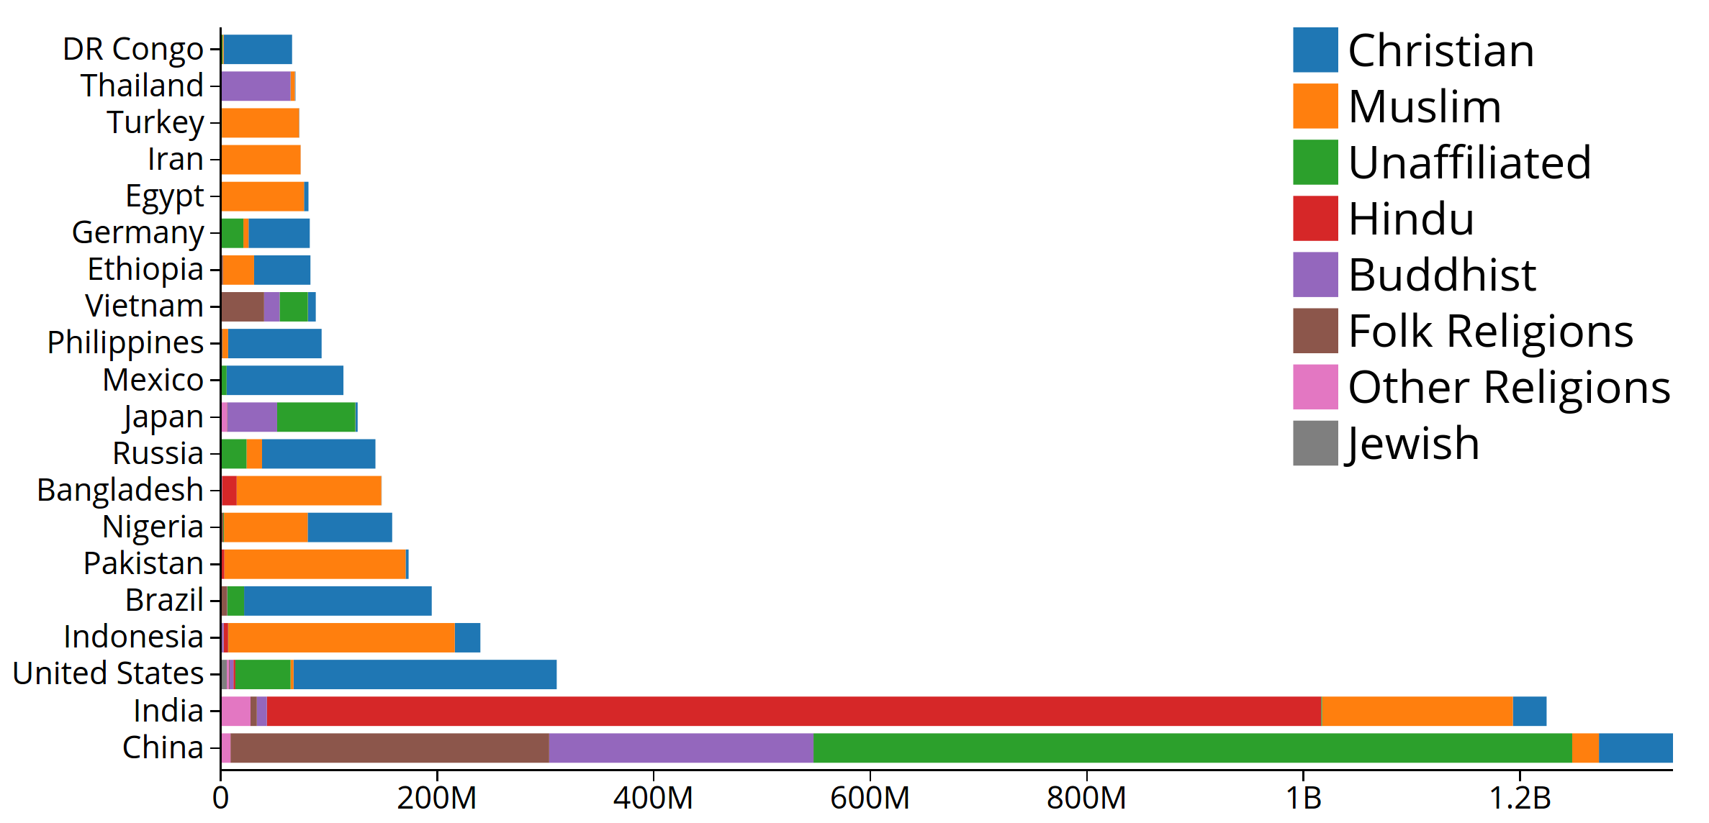

Slide 45
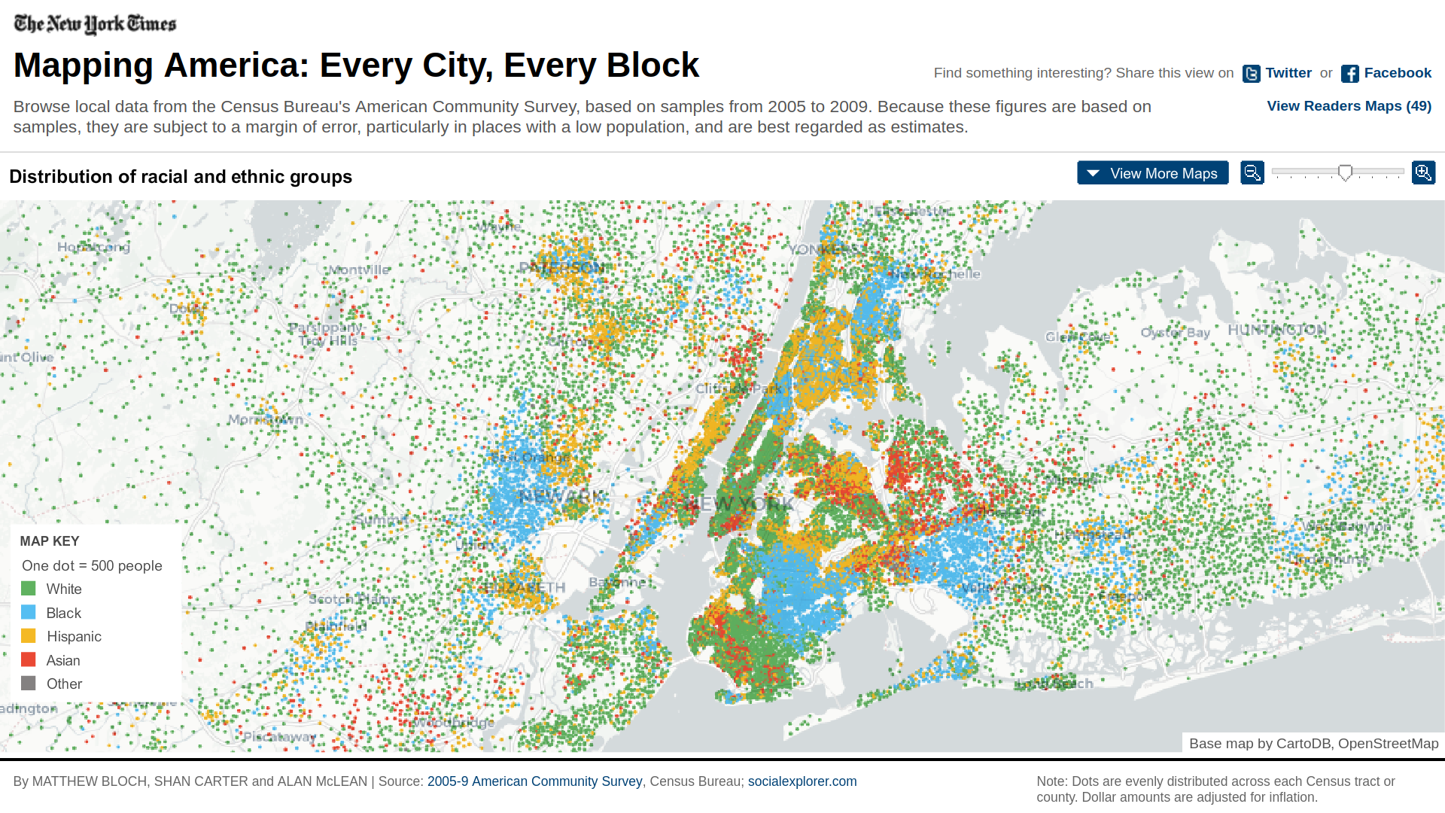

Slide 46
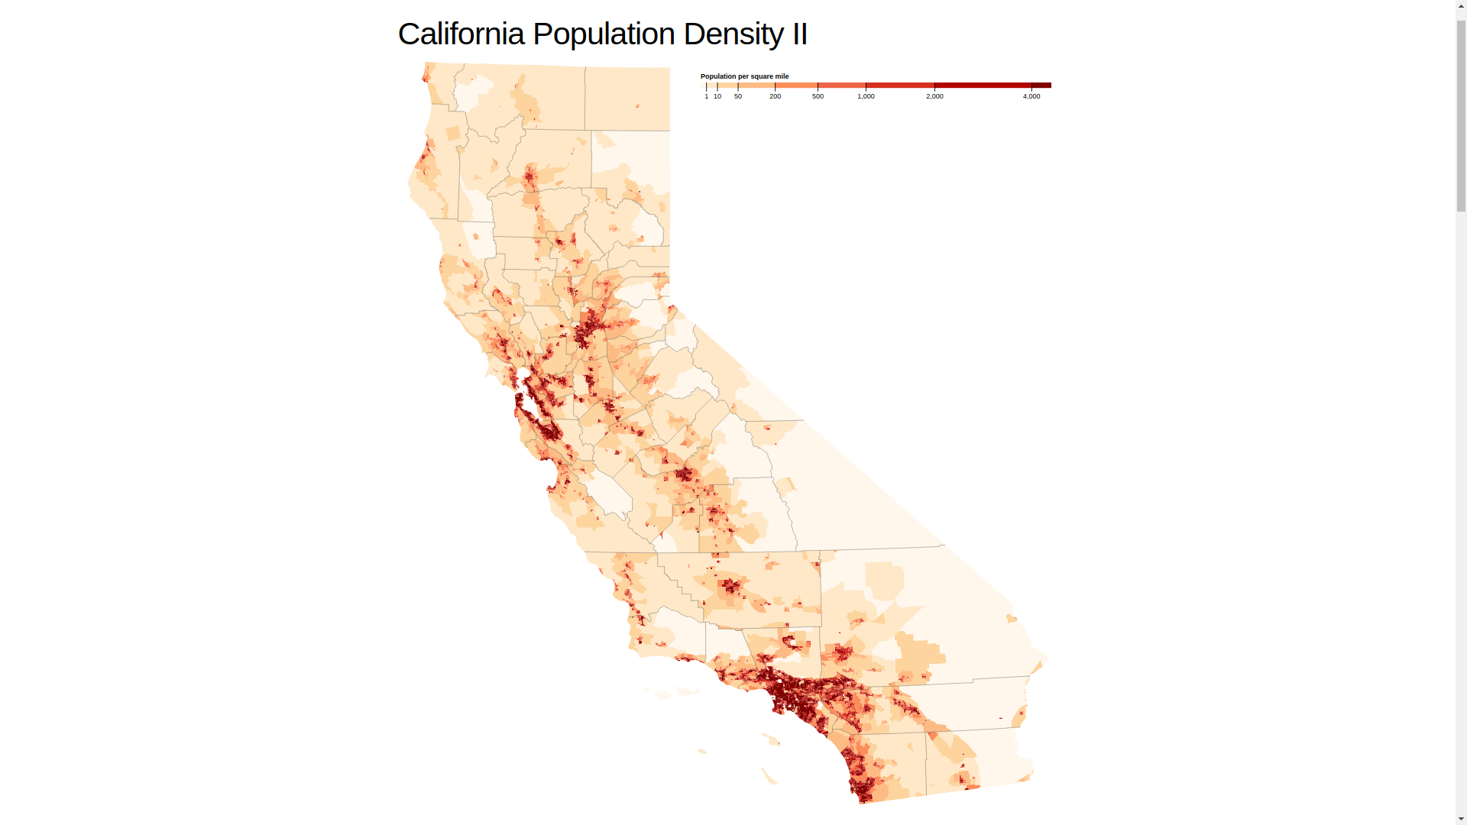

Slide 47
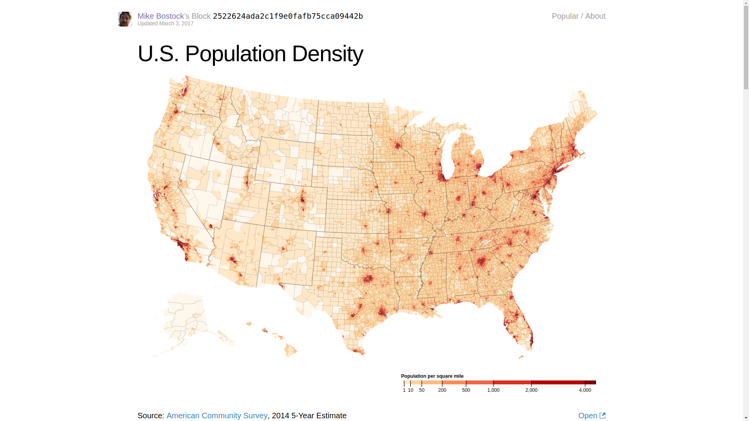

Slide 48
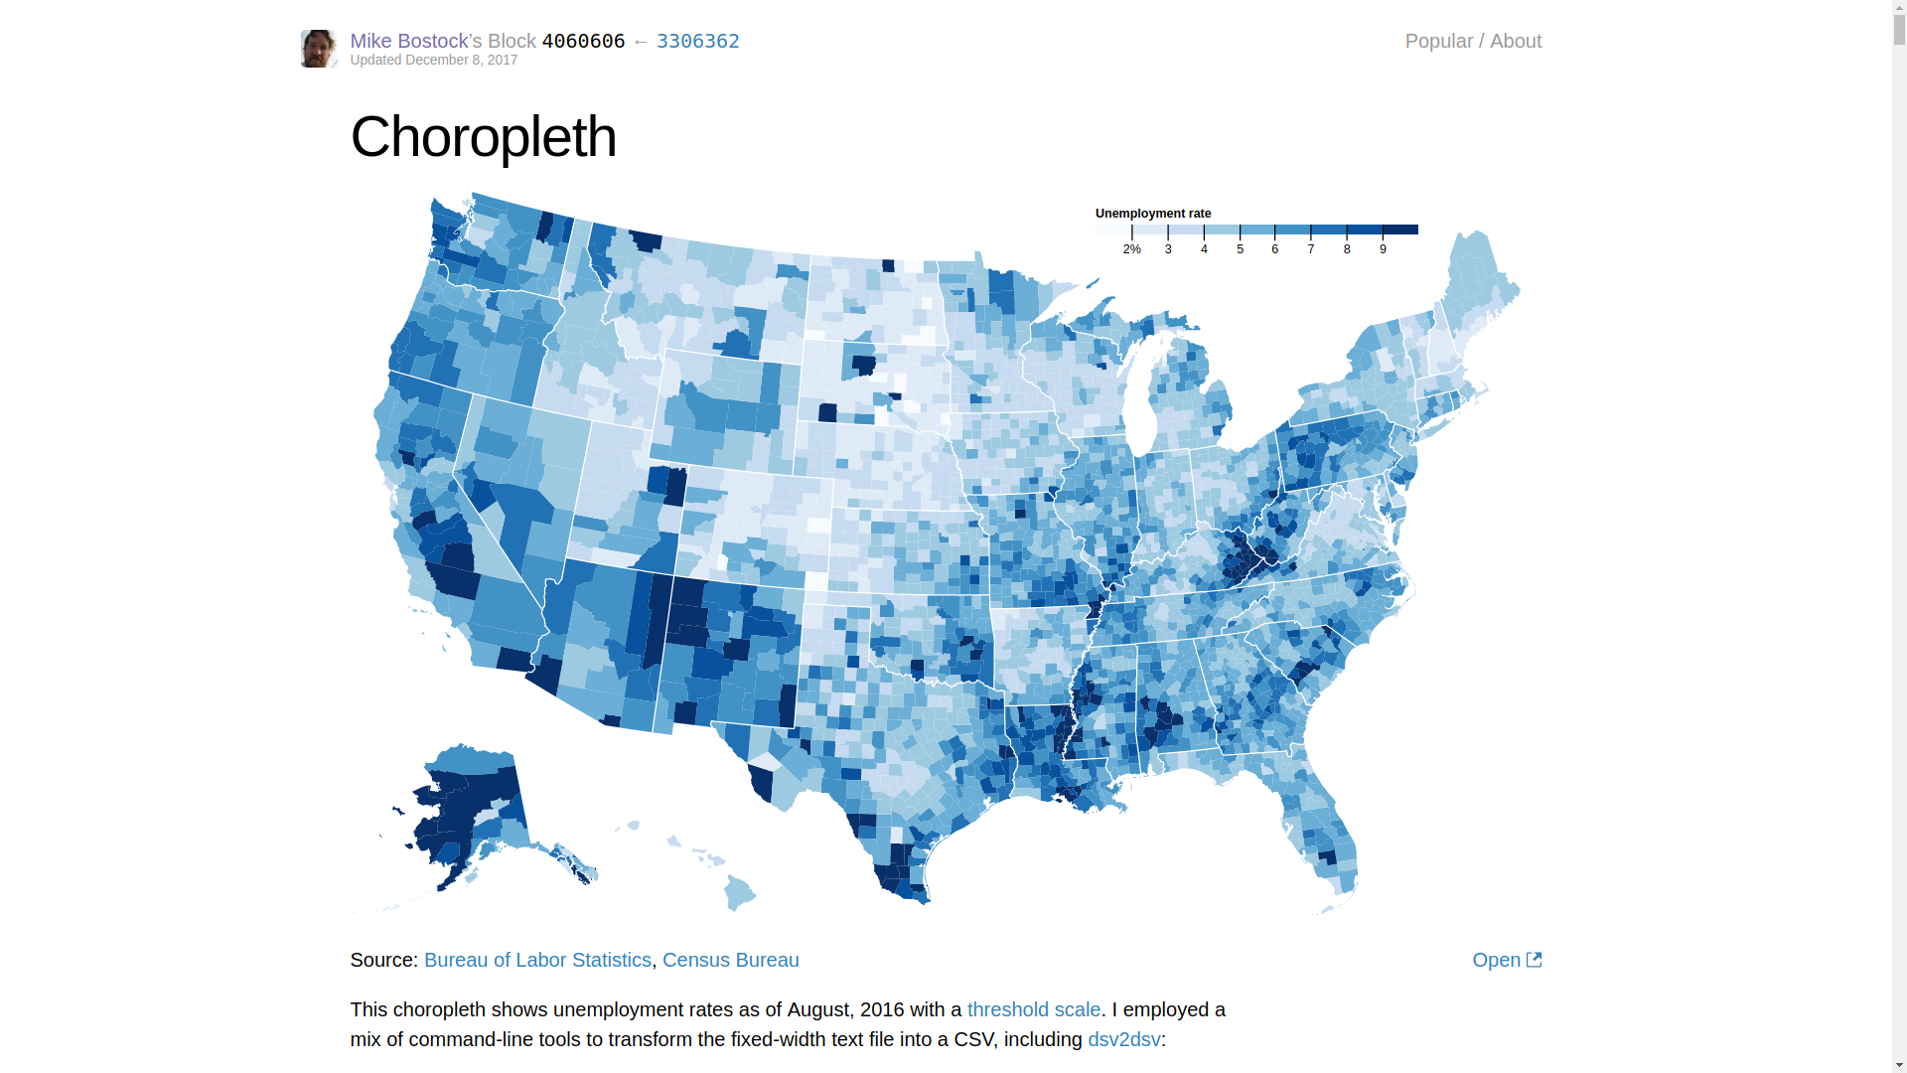

Slide 49
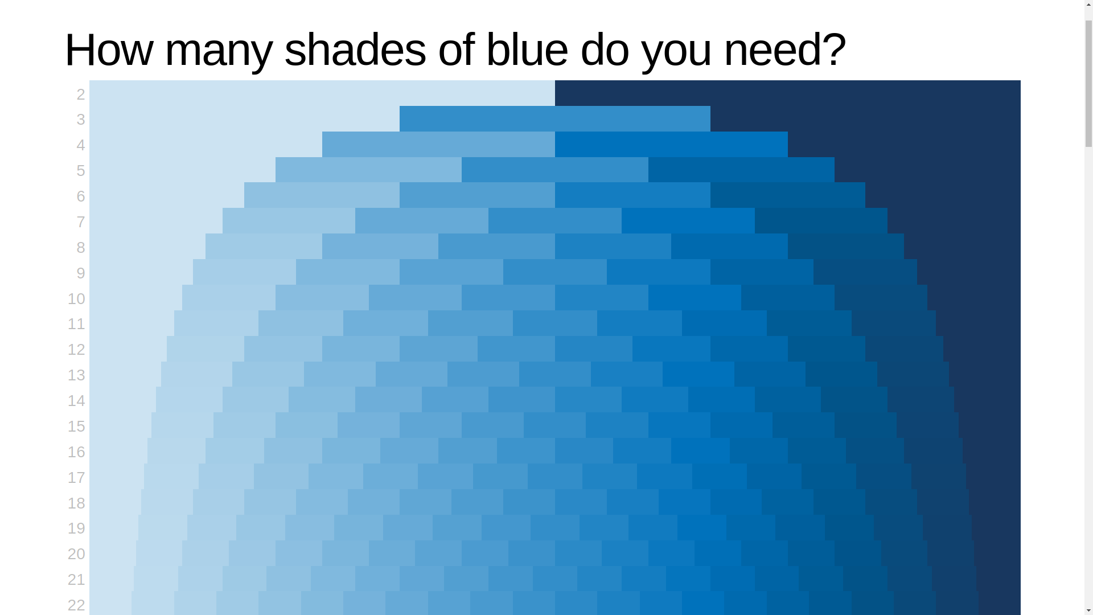

Slide 50
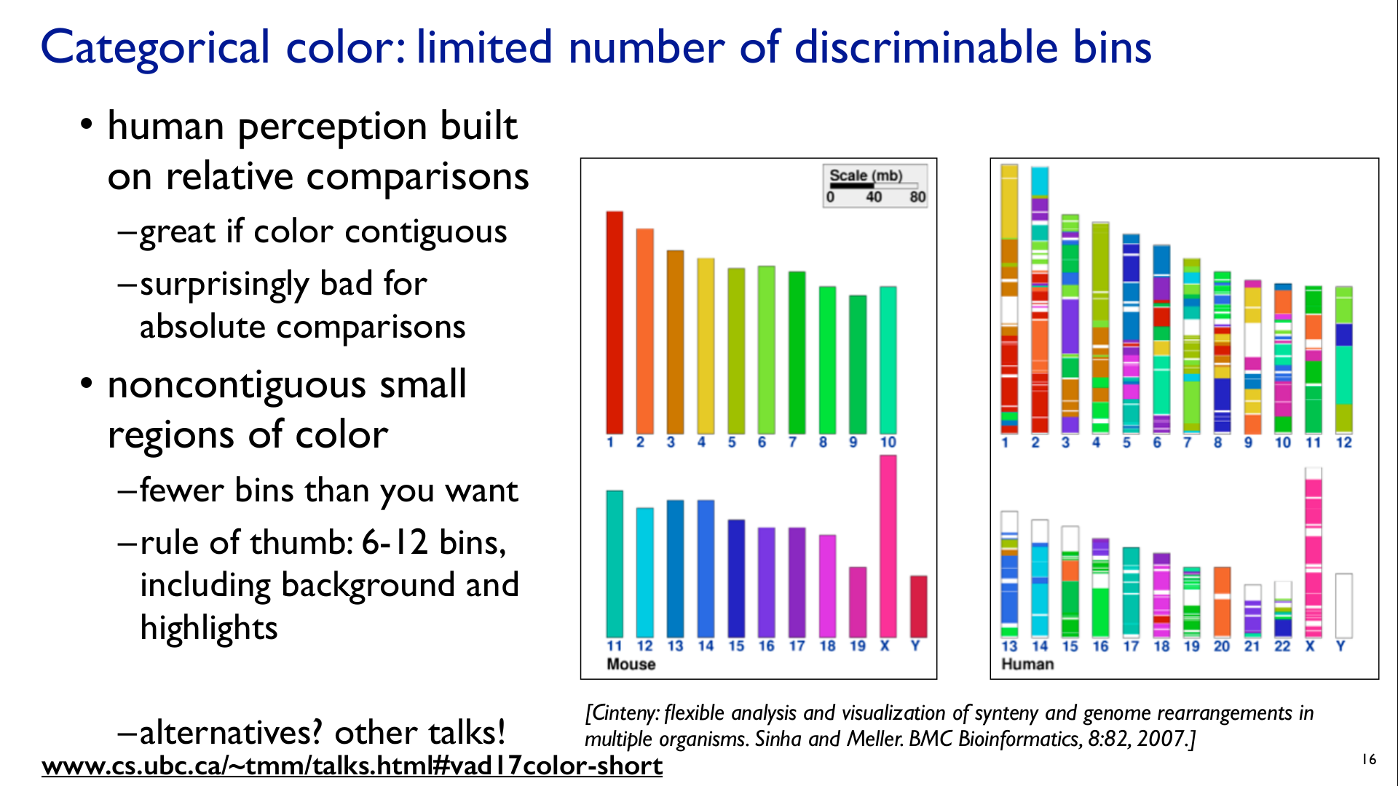

Slide 51
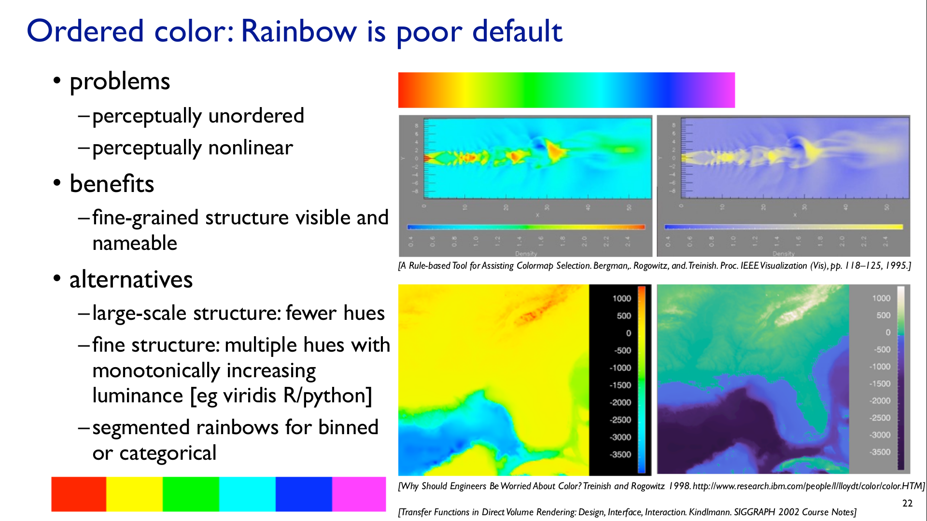

Slide 52
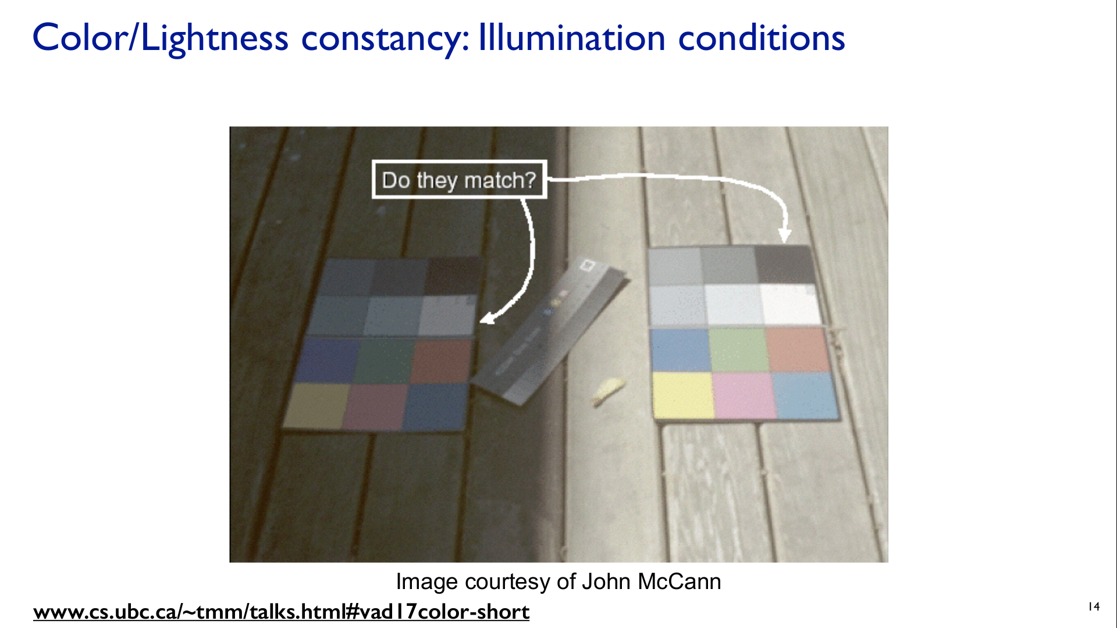

Slide 53
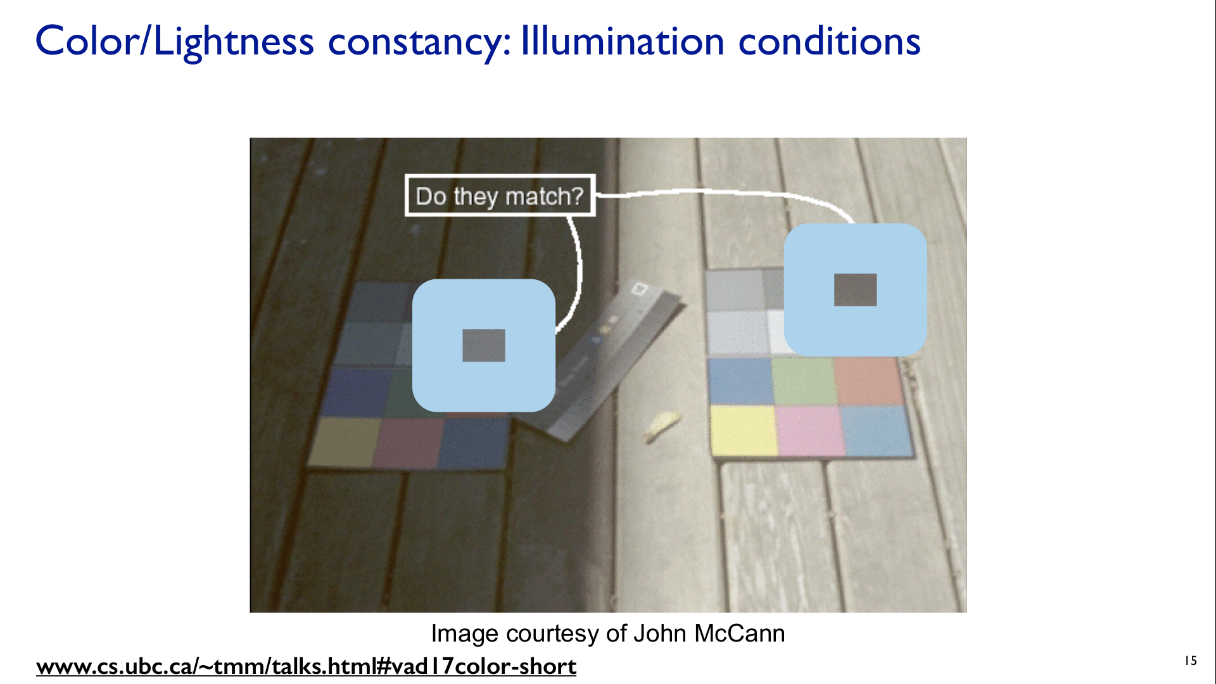

Slide 54
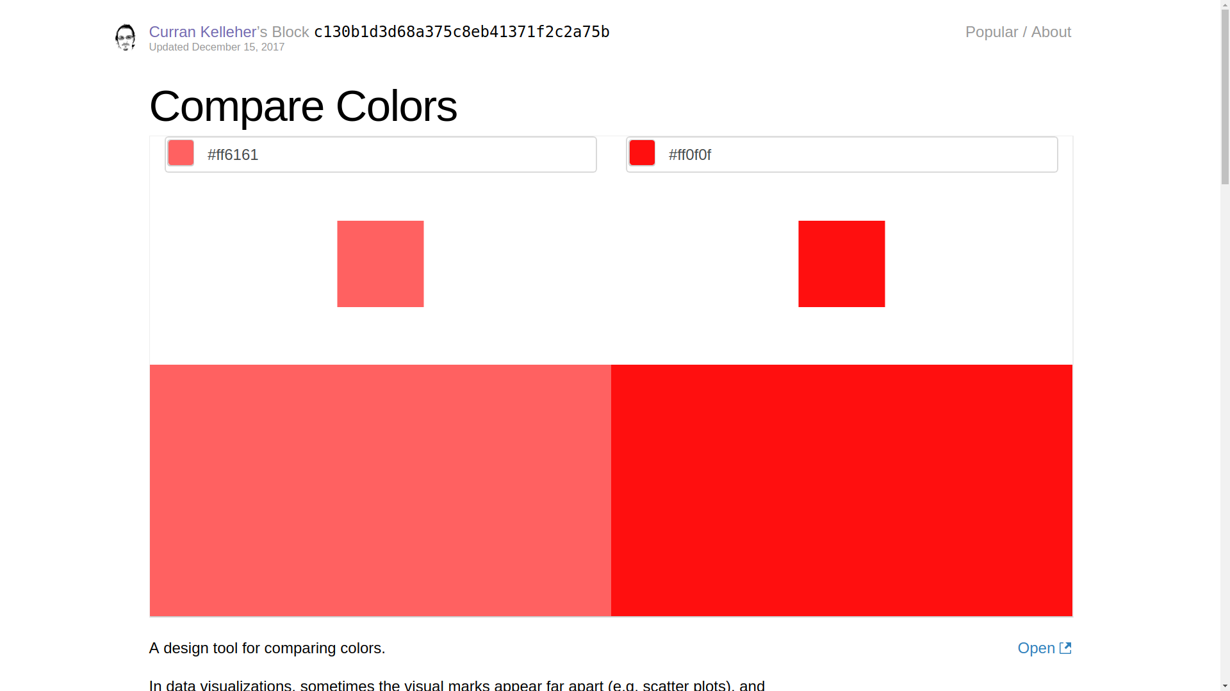

Slide 55
D3 Scale
https://github.com/d3/d3-scale

Slide 56
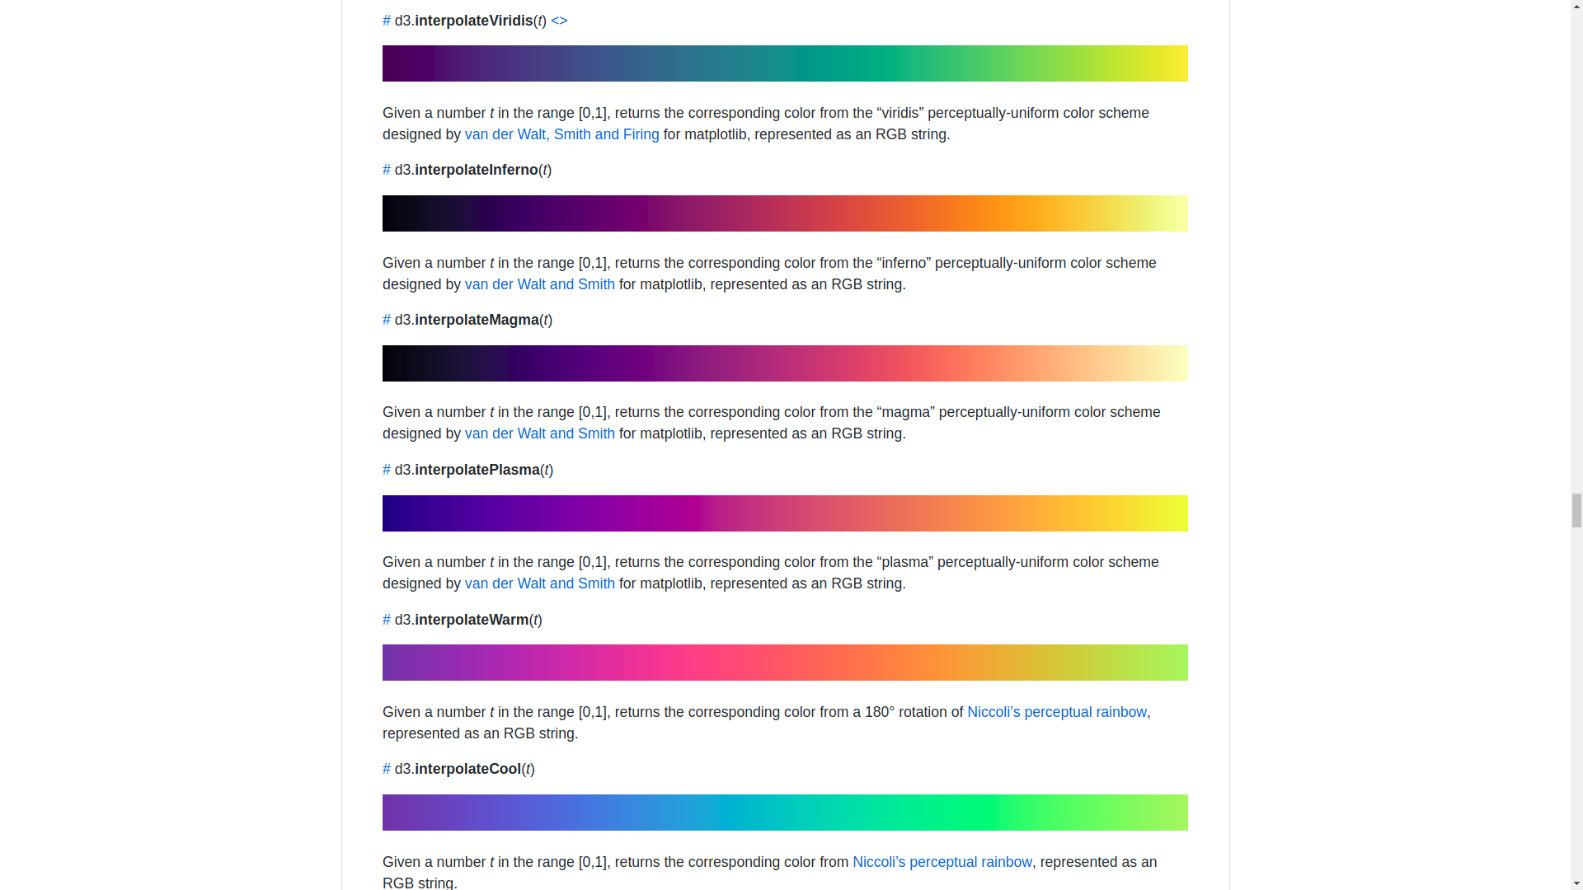

Slide 57
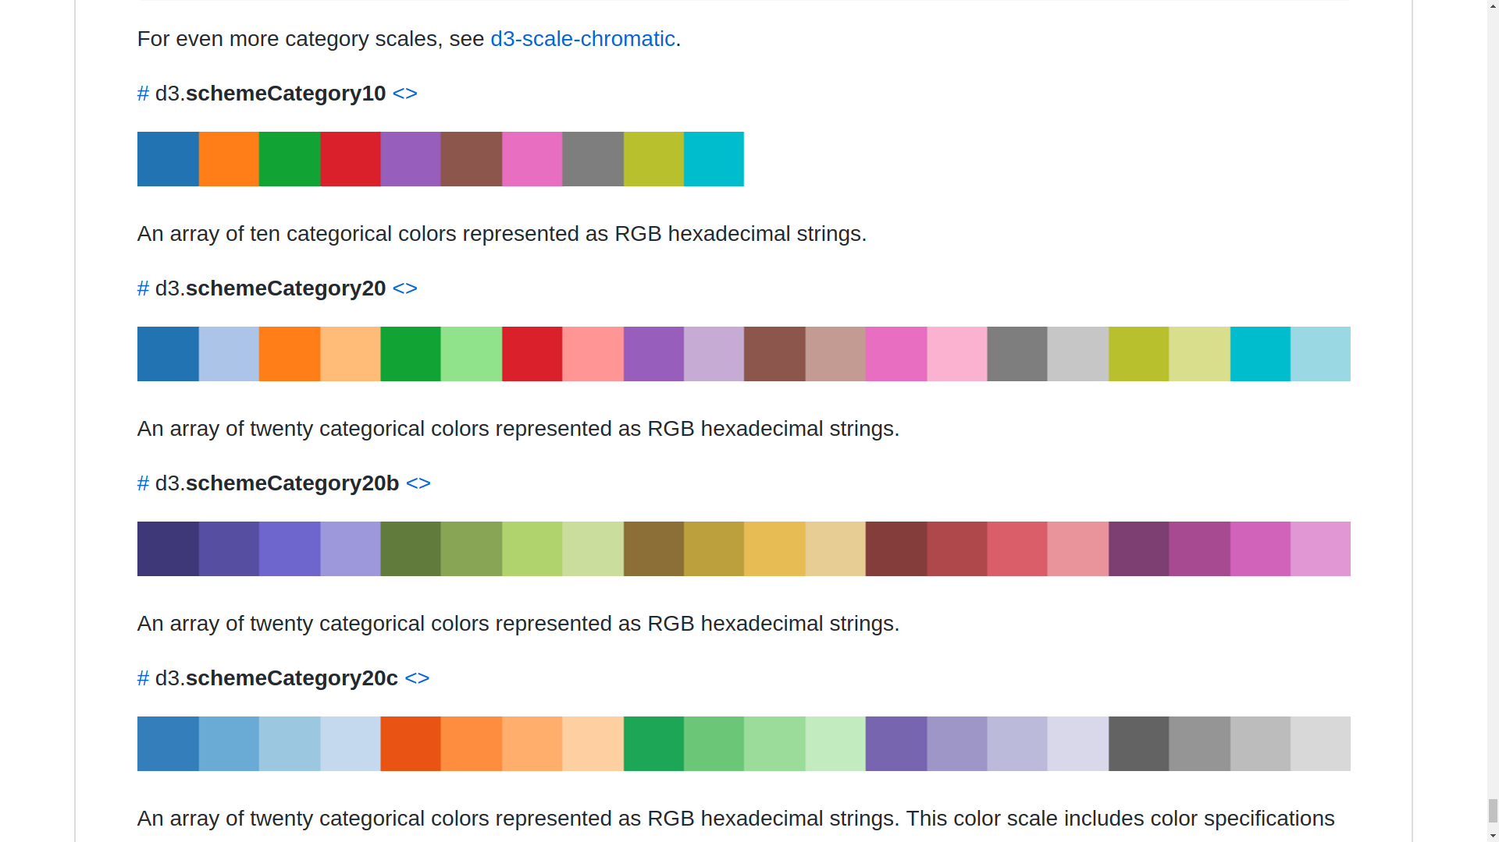

Slide 58
ColorBrewer
http://colorbrewer2.org

